Slide 1

Pubcoin
“Bringing crypto to your local breweries”
Matthew Newkirk, Endalkachew Desta, Abdullahi Said, James Reeves, Matt Houlk, and Blake Cizek

Slide 2
Executive Summary
Learning Objectives:
Develop technical expertise in creating fungible tokens and transaction functions deployed as solidity contracts on the ethereum blockchain
Project Objectives:
Leveraging ERC20, create a TaaS (Token-as-a-Service) marketplace for small businesses, breweries for this iteration, to reward its customers for brand loyalty and for customers to exchange their tokens across the network
Summary:
Developed and minted the “PubCoin” as the asset by which businesses can register a stake in the loyalty token and/or mint their own token at a specified exchange rate for PubCoins
Customers who register on the “PubCoin” marketplace can exchange tokens with fellow patrons and be rewarded additional tokens or exchange their balance for product/services by their brewery of choice for brand loyalty

Slide 3
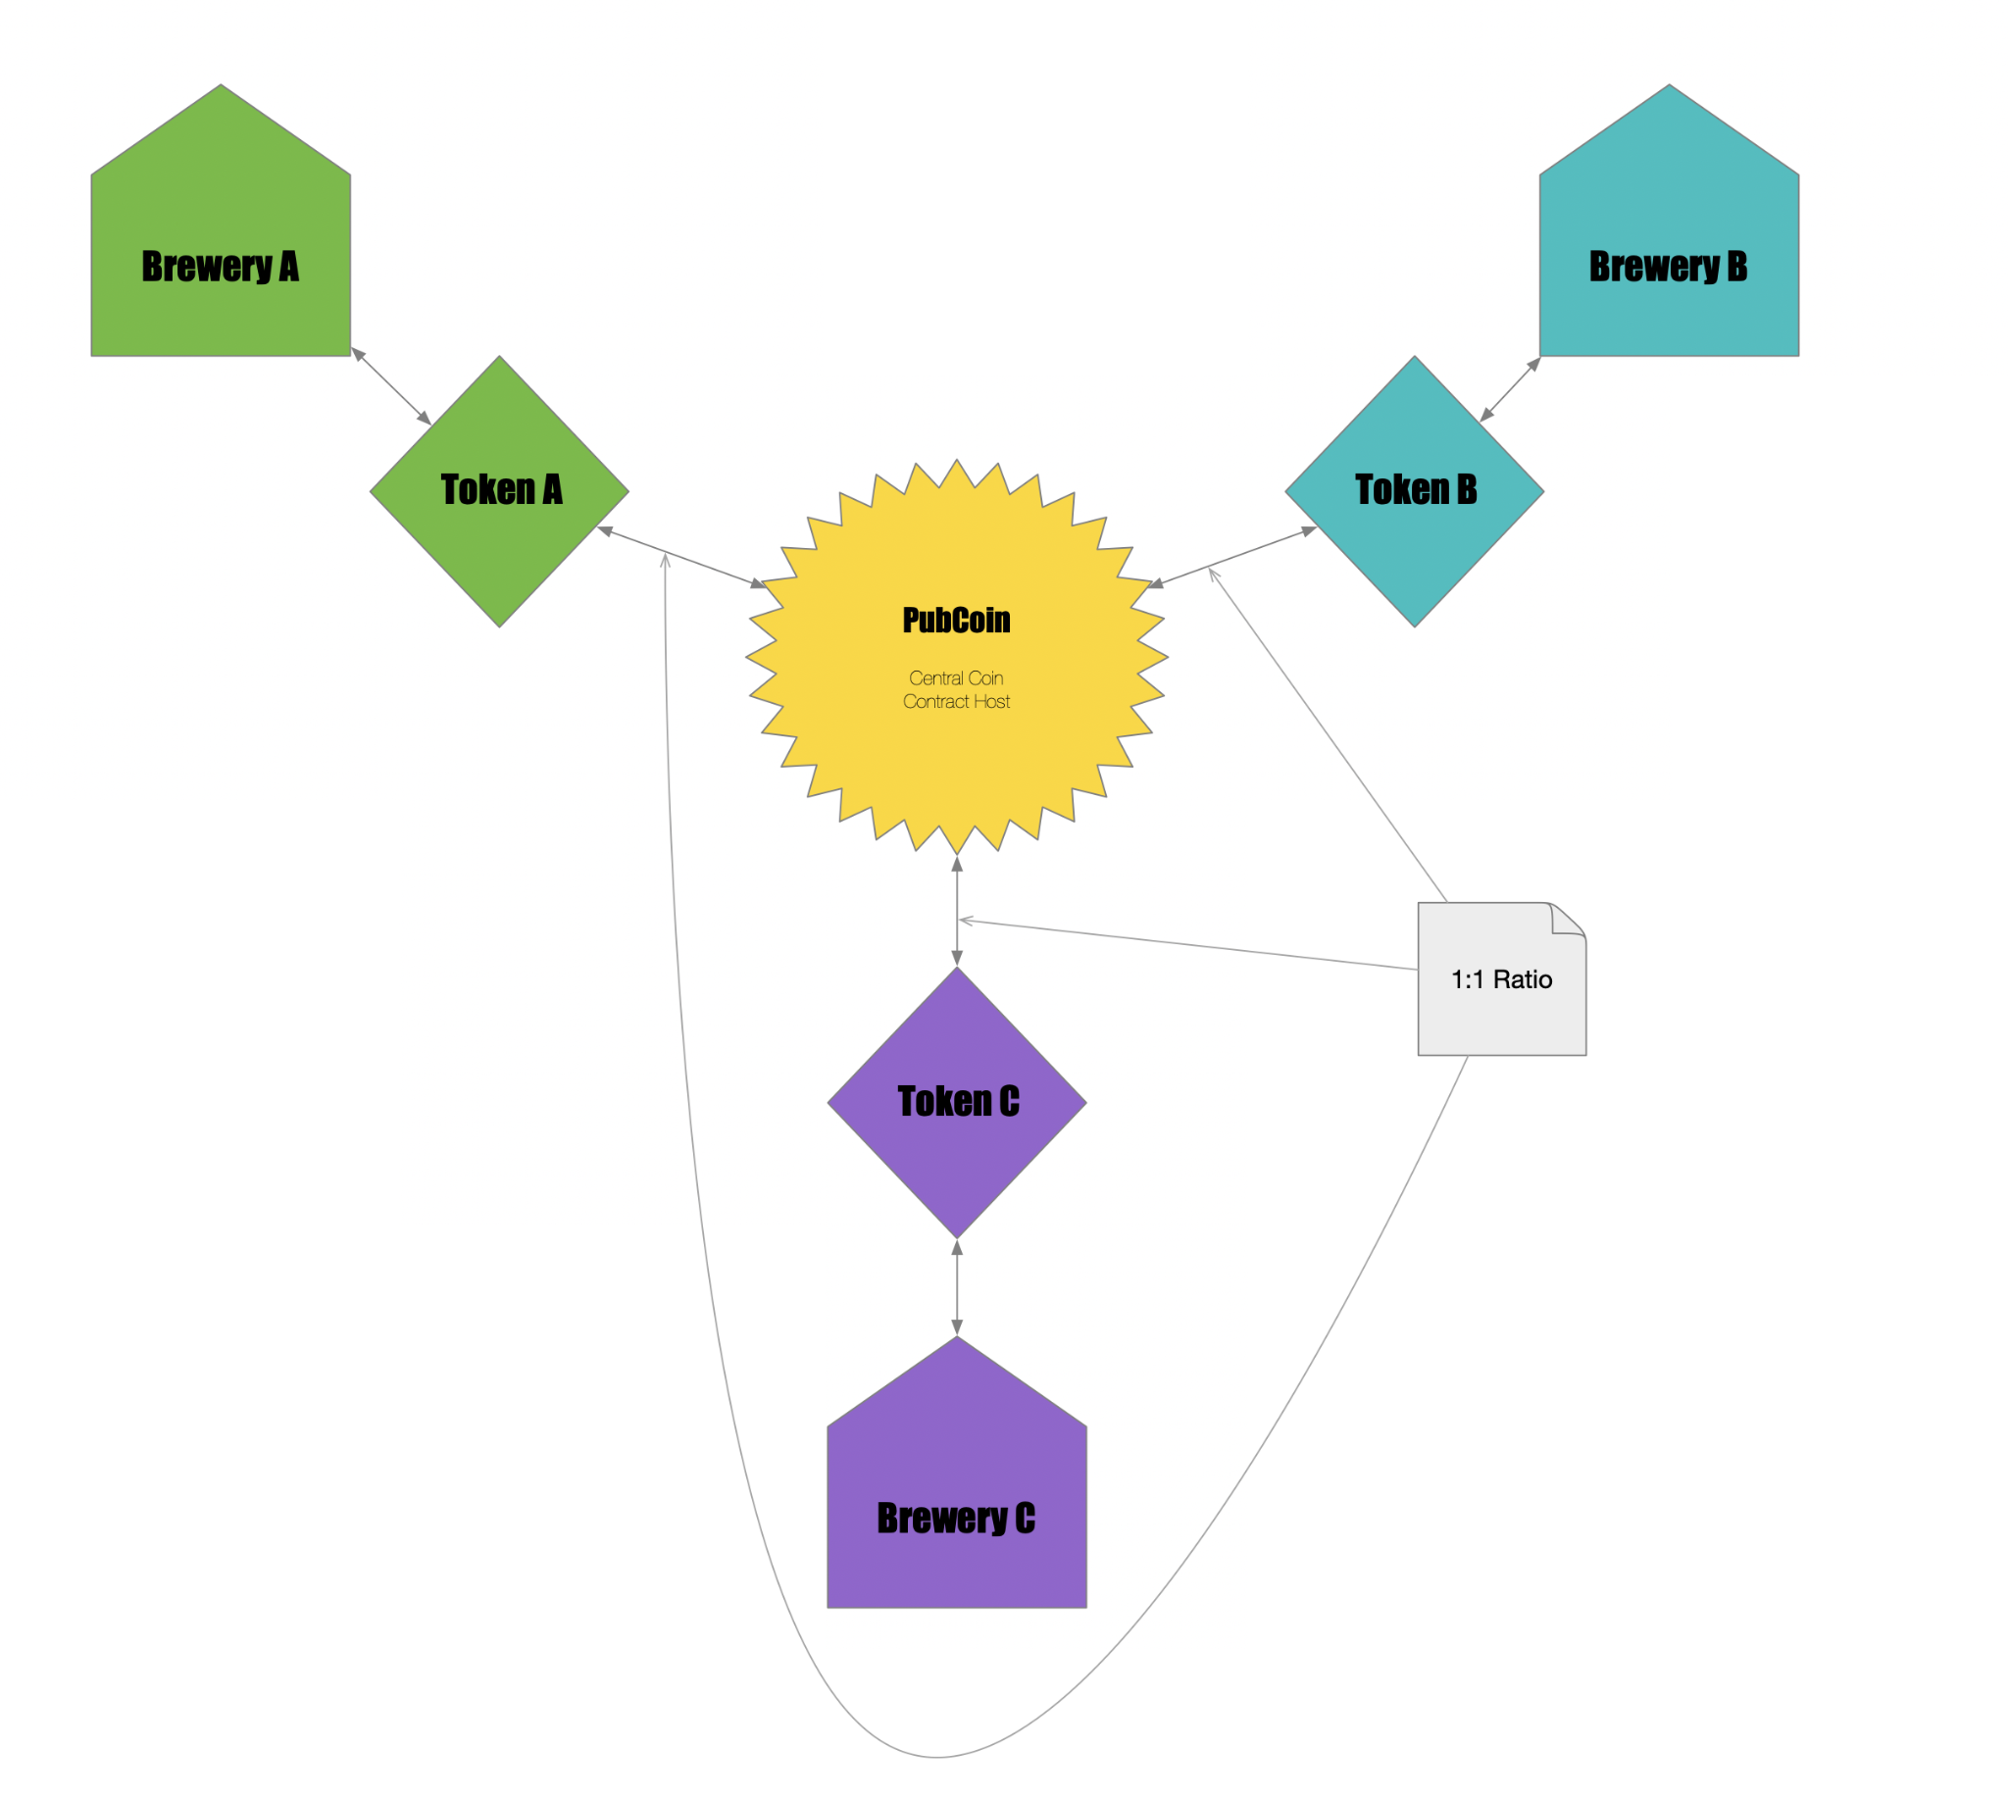
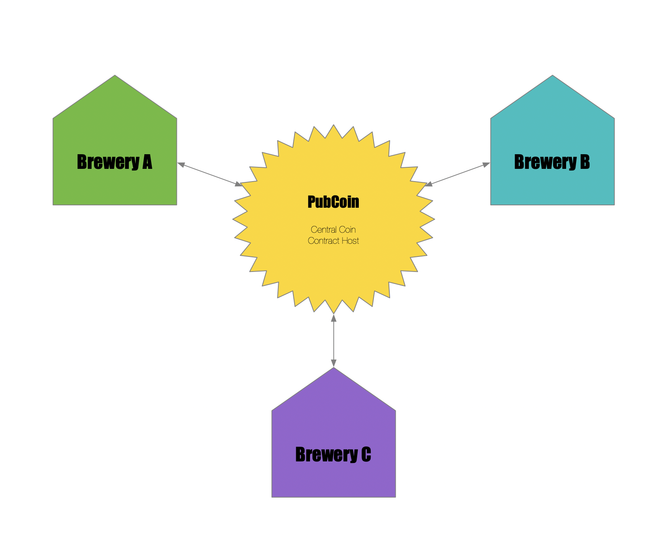
Conceptual Foundation and Inspiration
Multi-Token System
Single-Token System

Slide 4
Technical Summary
Tools & Standards used:
Developed in Remix and used MetaMask to deploy locally via Ganache and to the Ropsten Testnet
PubCoin token was minted using standards from ERC20, ERC20 Mintable and ERC20 Detailed
Contracts developed:
Pubcoin contract used to mint “PubCoin”, and any unique brewery token
PointsTokenStorage, and Ownable contracts used to initialize PubCoin_Points
PubCoin_Points contracts designed to enable registration of businesses and customers and the transaction of PubCoins across the marketplace
Why Blockchain for Rewards/Loyalty Points system?
Traditional loyalty systems suffer from low redemption rates, high costs, few customer incentives and security concerns
Blockchain systems offer open systems, less clutter, more flexibility, reduced costs, overall transparency, less fraud, and more security
Value Adds: Easier implementation, better accounting, happier customers, access to a network of loyal customers
Notes:
Why a loyalty program:
Repeat customers generate 40% of a store’s revenue
62% of millennial shoppers and 54% of the larger population tend to only buy from their preferred brand
The top 10% of customers spend 3 times more per order than the average customer with the top 1% spending 5 times more
Reasons for putting on blockchain:
Legacy systems falling out of favor with modern customers due to complex registration processes and juggling multiple cards for each store or brand
When customers don’t use points or rewards, these end up staying as liabilities on the company’s books
Legacy systems suffer from:
Low redemption rate, high costs, few customer incentives and security concerns, and complex redemption systems
Easier implementation for shops of all sizes
Happier customers due to having more control and ownership of their loyalty points with flexibility over their rewards with more frictionless experience
Access to a network of loyal customer networks from other shared brands on the token blockchain
Better accounting
Streamlined account management with no need for spreadsheets, multiple cards or accounts
Features of blockchain loyalty system:
Open systems: Token cannot be revoked, company cannot take points away lending to increased customer loyalty
Less clutter: Tokens can be used at other stores, traded, or stored for a future time, thus the customer does not have to juggle multiple accounts
More flexibility: More freedom for customers to redeem loyalty tokens and in smaller increments with less complexity from the customer’s point of view
Reduced costs: Programs won't take years and hundreds of thousands of dollars to implement and maintain, and because of the native ledger, you already have a loyalty record
Overall Transparency: Customers know rules cannot be changed or tokens revoked based on company rules like legacy systems
Less fraud, more security: Due to blockchain based on P2P systems, there is a far less likely chance of a breach in the program as all info is stored immutably on the blockchain and all data entries are timestamped

Slide 5
PubCoin Demo

Slide 6
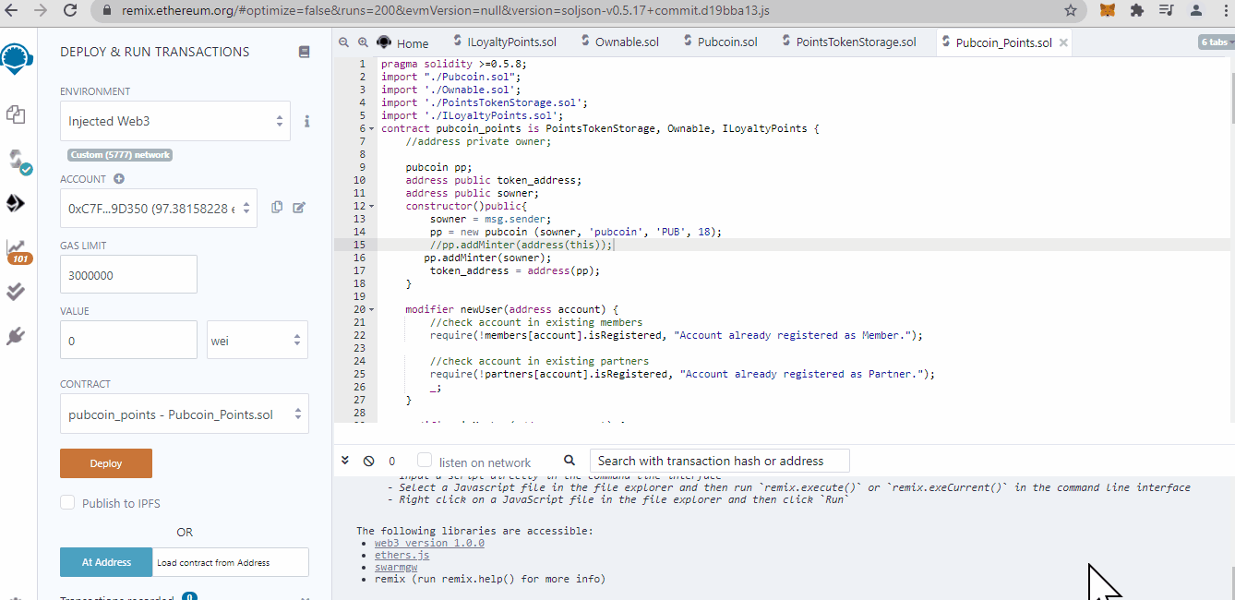
Initial Deployment

Slide 7
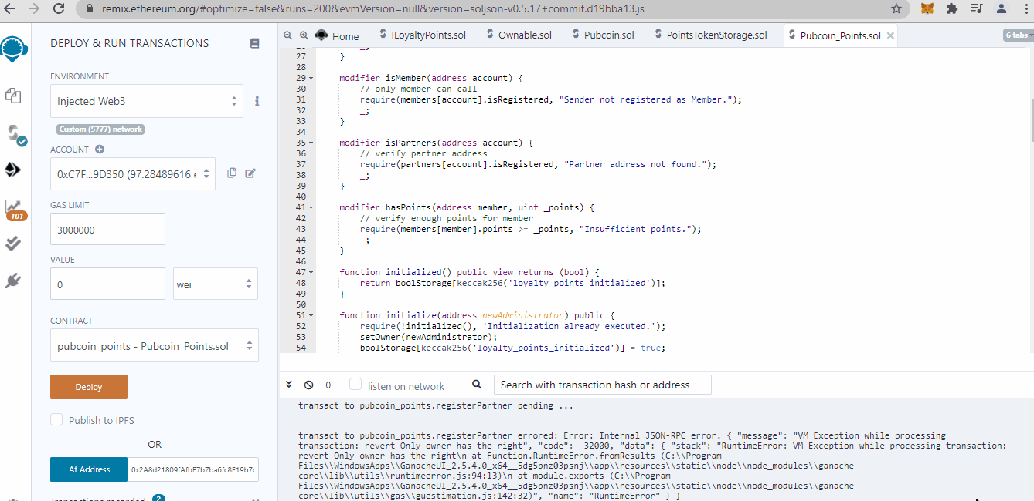
Initialization Registration

Slide 8
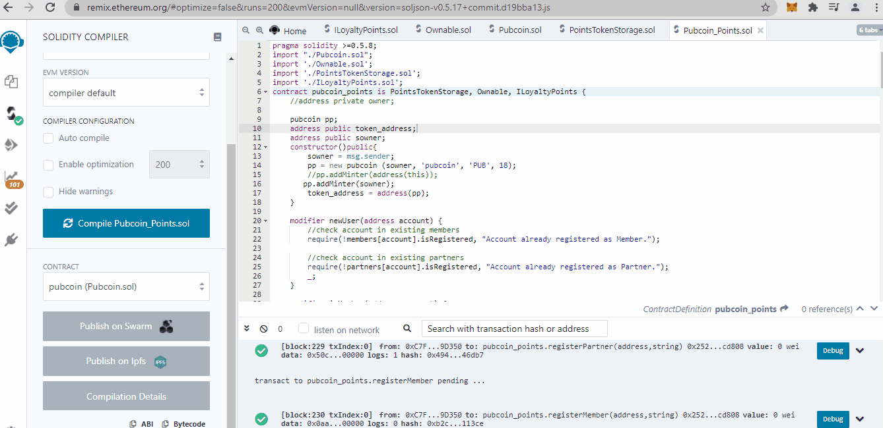
One Click dApp Deployment

Slide 9
Retrospective
Challenges:
Working backwards from the original ideas of providing every small business with a means to create a token to reward customers and to create excitement around their brand took many discussions to convert concept scope to code
Still haven’t quite fully rationalized both in concept and in execution the dynamics of creating a Multi-token vs Single-Global-token for “PubCoin” loyalty points
A “teething” experience in developing expertise in solidity and deploying to a Testnet
Issues in creating a front-end to the contracts, using One Click dApp as the constructor
Future Roadmap:
Iron out tokennomics of a multi-token vs. single-token loyalty marketplace
Evaluate If ERC777 is a better choice than ERC20
Possible develop a front-end application for the contracts

Slide 10
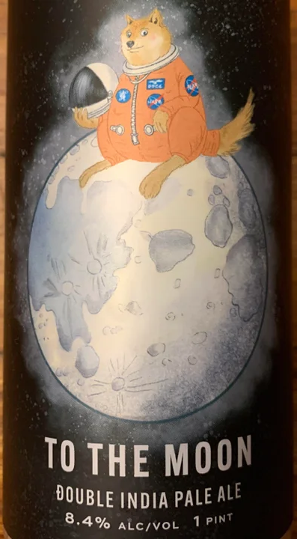
Questions?

Slide 11
References
Customer Loyalty Blockchain: A New Ecommerce Rewards Program. The BigCommerce Blog. (2019, October 16). https://www.bigcommerce.com/blog/customer-loyalty-blockchain/#6-cases-for-blockchain-loyalty-tokens.
Deloitte. (2016, October 10). (rep.). Making Blockchain Real for Customer Loyalty Rewards Programs. Retrieved from https://www2.deloitte.com/content/dam/Deloitte/us/Documents/financial-services/us-fsi-making-blockchain-real-for-loyalty-rewards-programs.pdf
OpenZeppelin. (n.d.). OpenZeppelin/openzeppelin-contracts. GitHub. https://github.com/OpenZeppelin/openzeppelin-contracts.
Ryan-Rozario. (2019, April 10). ryan-rozario/loyalty_points. GitHub. https://github.com/ryan-rozario/loyalty_points/blob/master/contracts/loyalty_overview.sol.
One Click Dapp. (n.d.). https://oneclickdapp.com/.

